Slide 1



SHERLOCK HOLMES
&
THE INTERNET OF THINGS
Gaming experience
&
Collaborative STORYTELLING

Slide 2
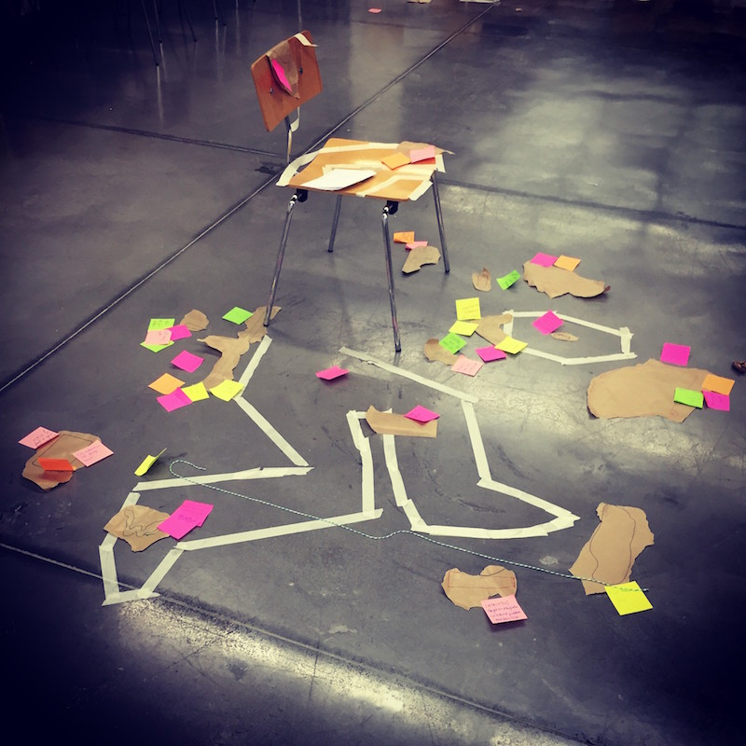
INTRODUCTION
The idea came from the collaboration with Crossmedia Factory,that for the event Vaporosamente will propose again Sherlock IoT to the public, an experimentation of “immersive storytelling game”, a kind of role game that requires the creativity of the partecipants to improve their experience users-creators.
This time, the story is set in Turin, in 1834, during the Universal Exposition. Beyond an amazing Steampunk background there is a mysterious society full of secrets. It’s up to the players trying to solve them all.

Slide 3
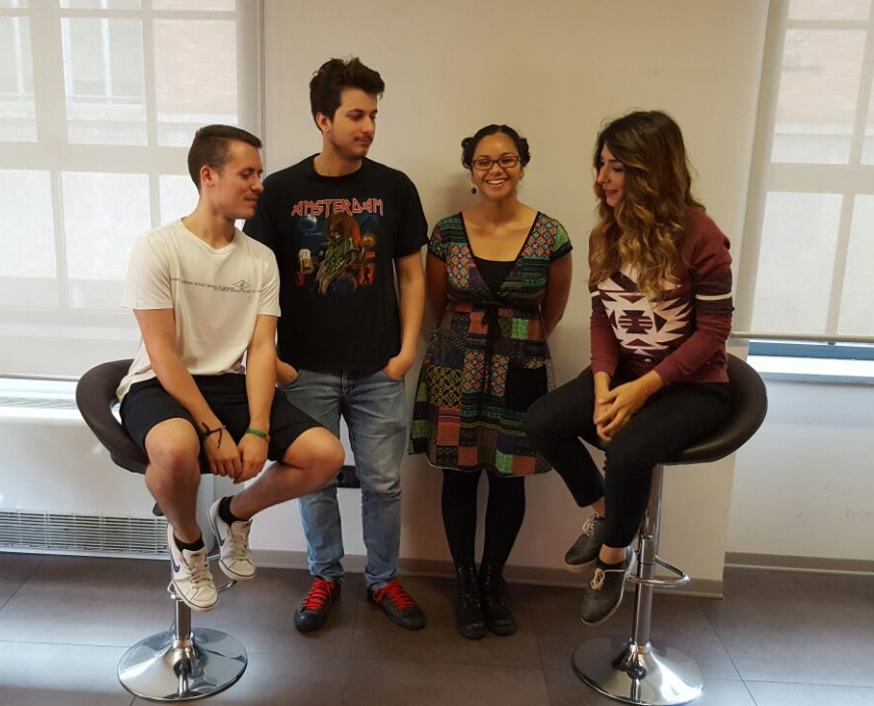
THE TEAM
Elahe Salarzehi
Luca Scudeler
Matteo Lanzetti
Vanessa Libora

Slide 4
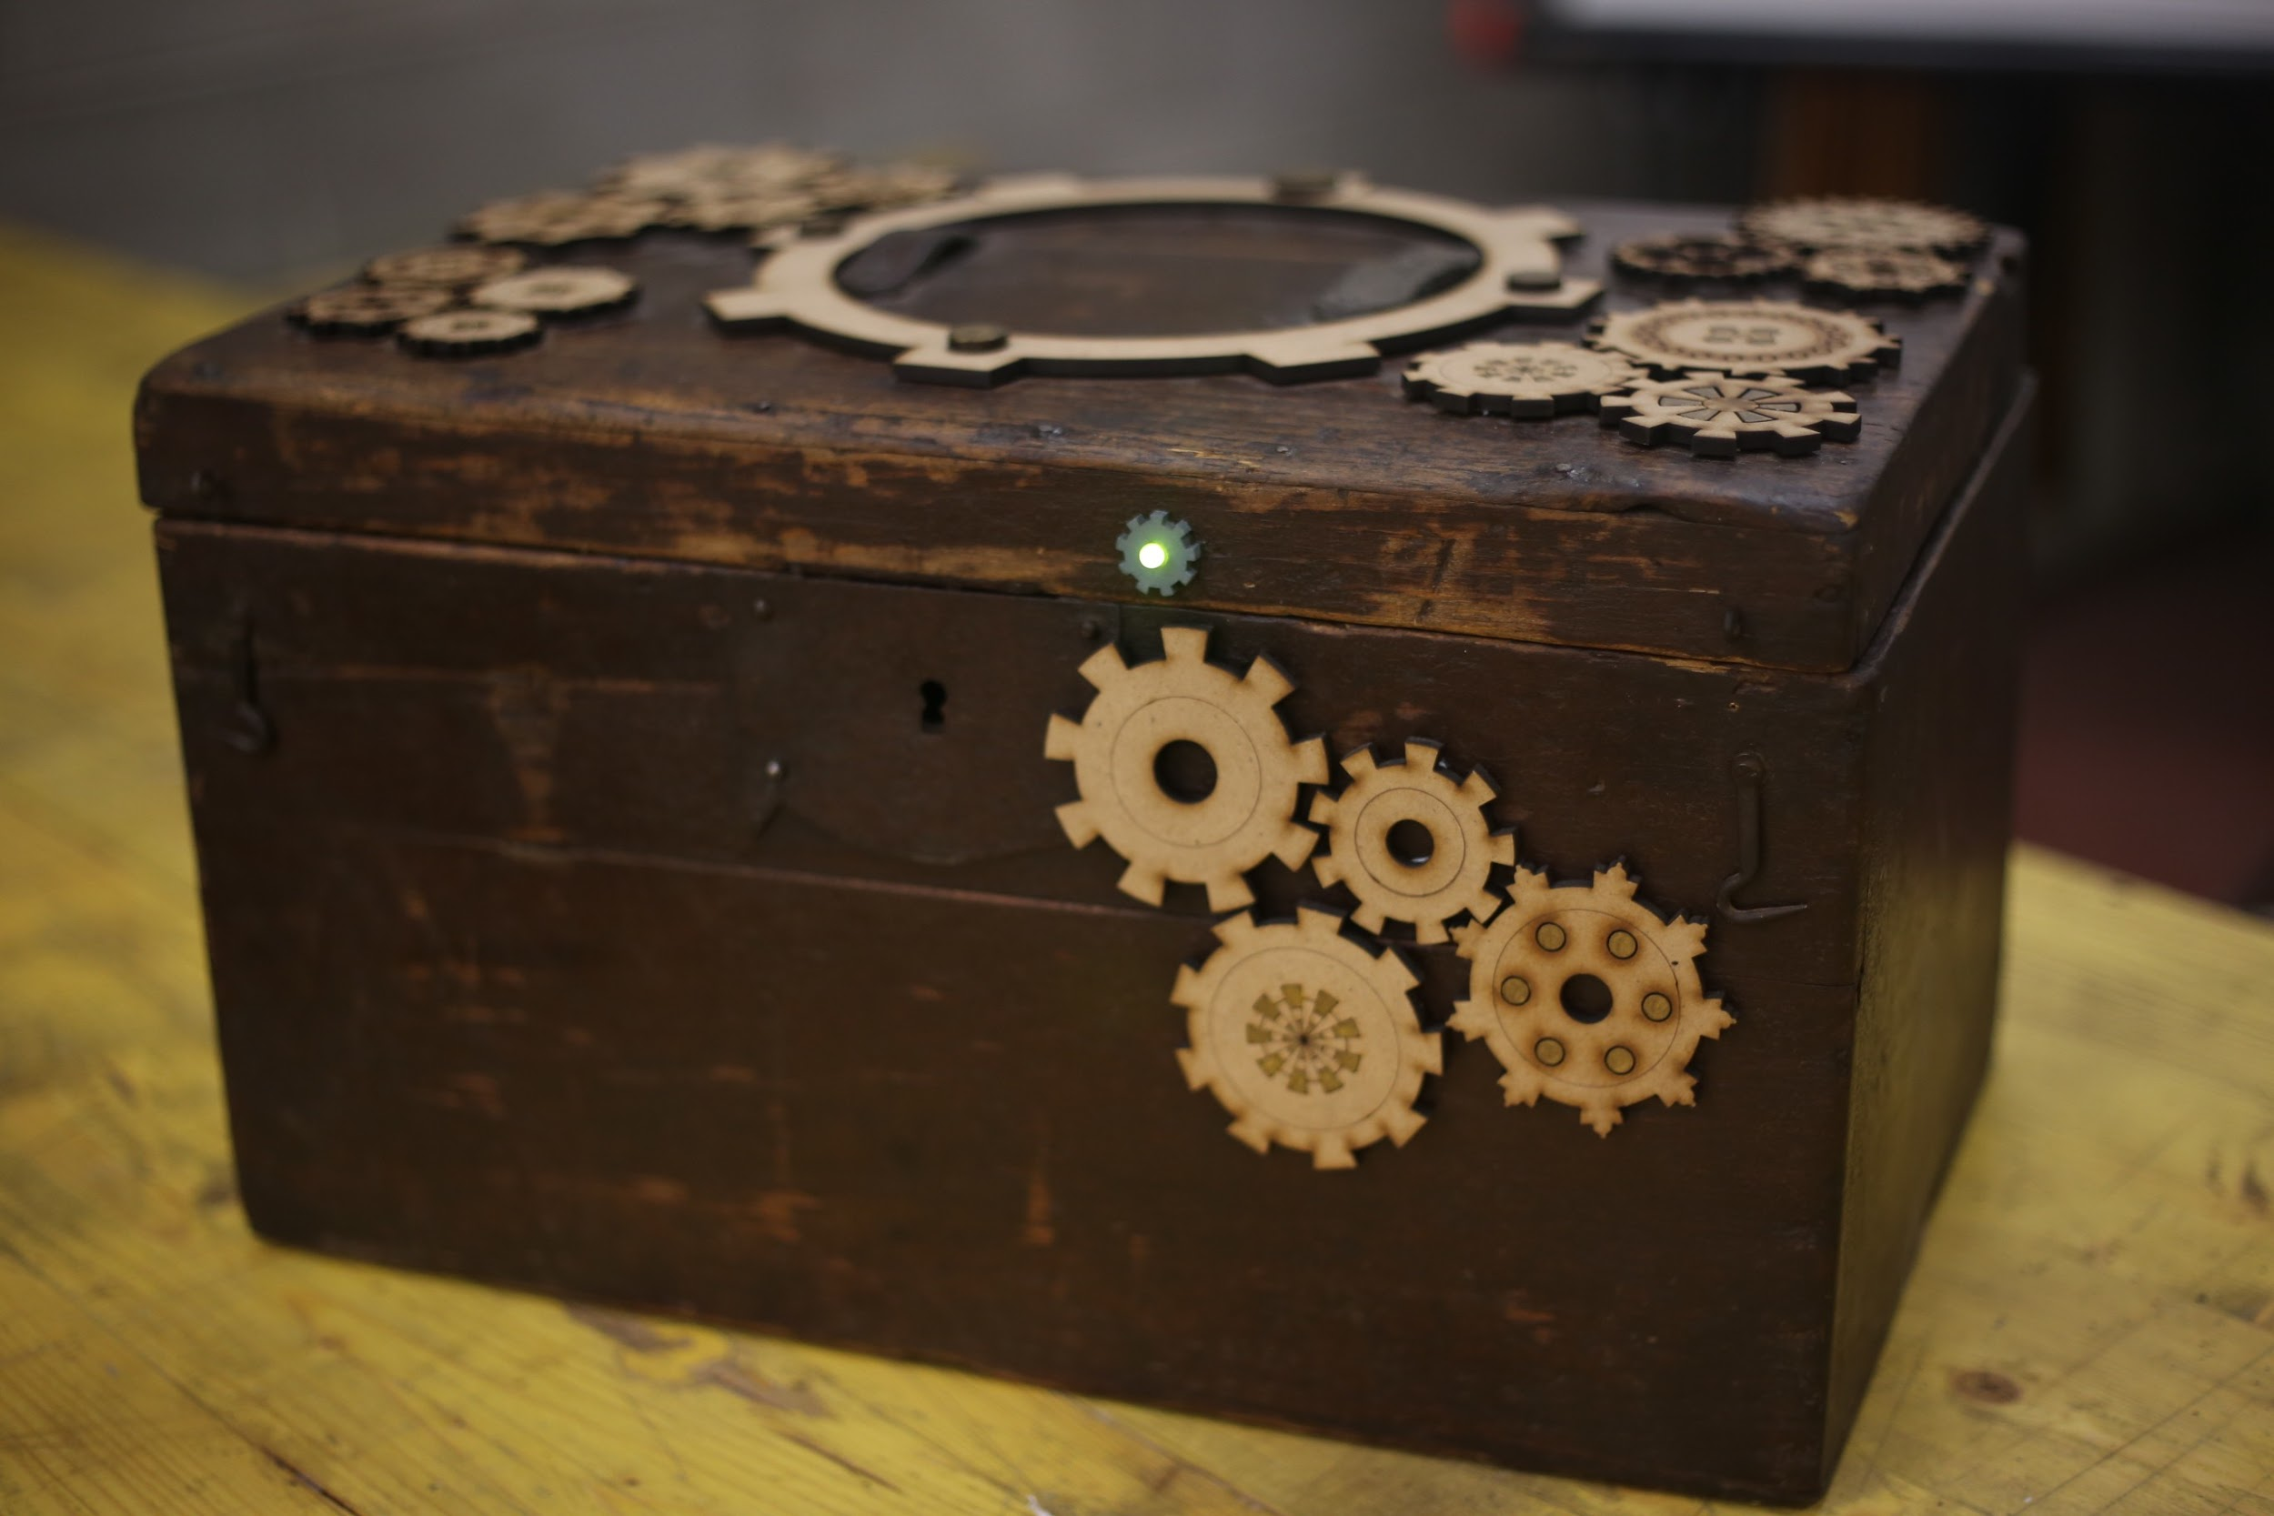
OBJECTIVE OF THE GAME
The Sherlock IoT players will have to find several clues hidden insight the location. We decided that there wasn’t a better hiding place than an old and weird looking box, with a secret locking
system...

Slide 5
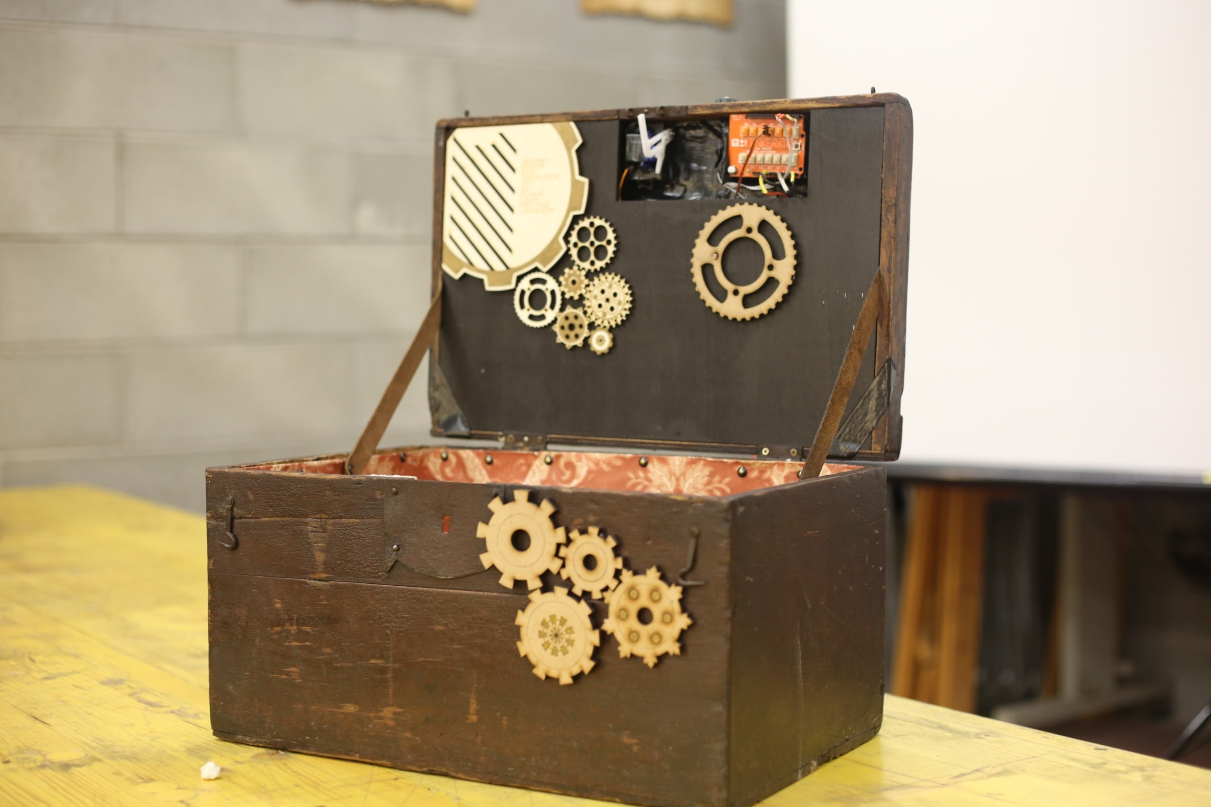
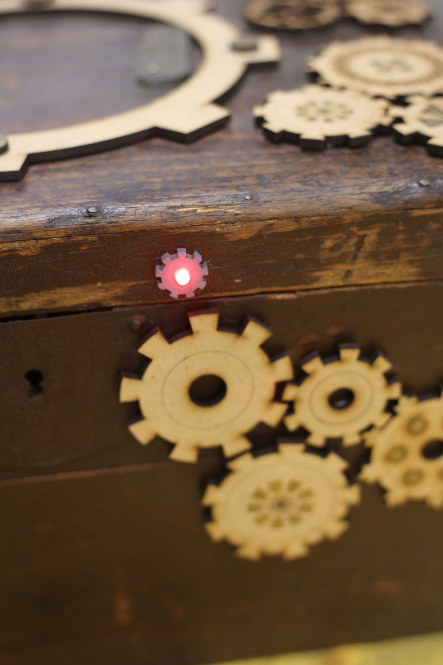
DESCRIPTION KNOCK LOCK BOX
We are talking about a closed box with a particular lock: the lock could be opened only knocking at the box using a specific combination of knocks.
The Knock Lock method is used.
Until the box is closed, a red led will be on: it will turn green only at the opening of the box.

Slide 6
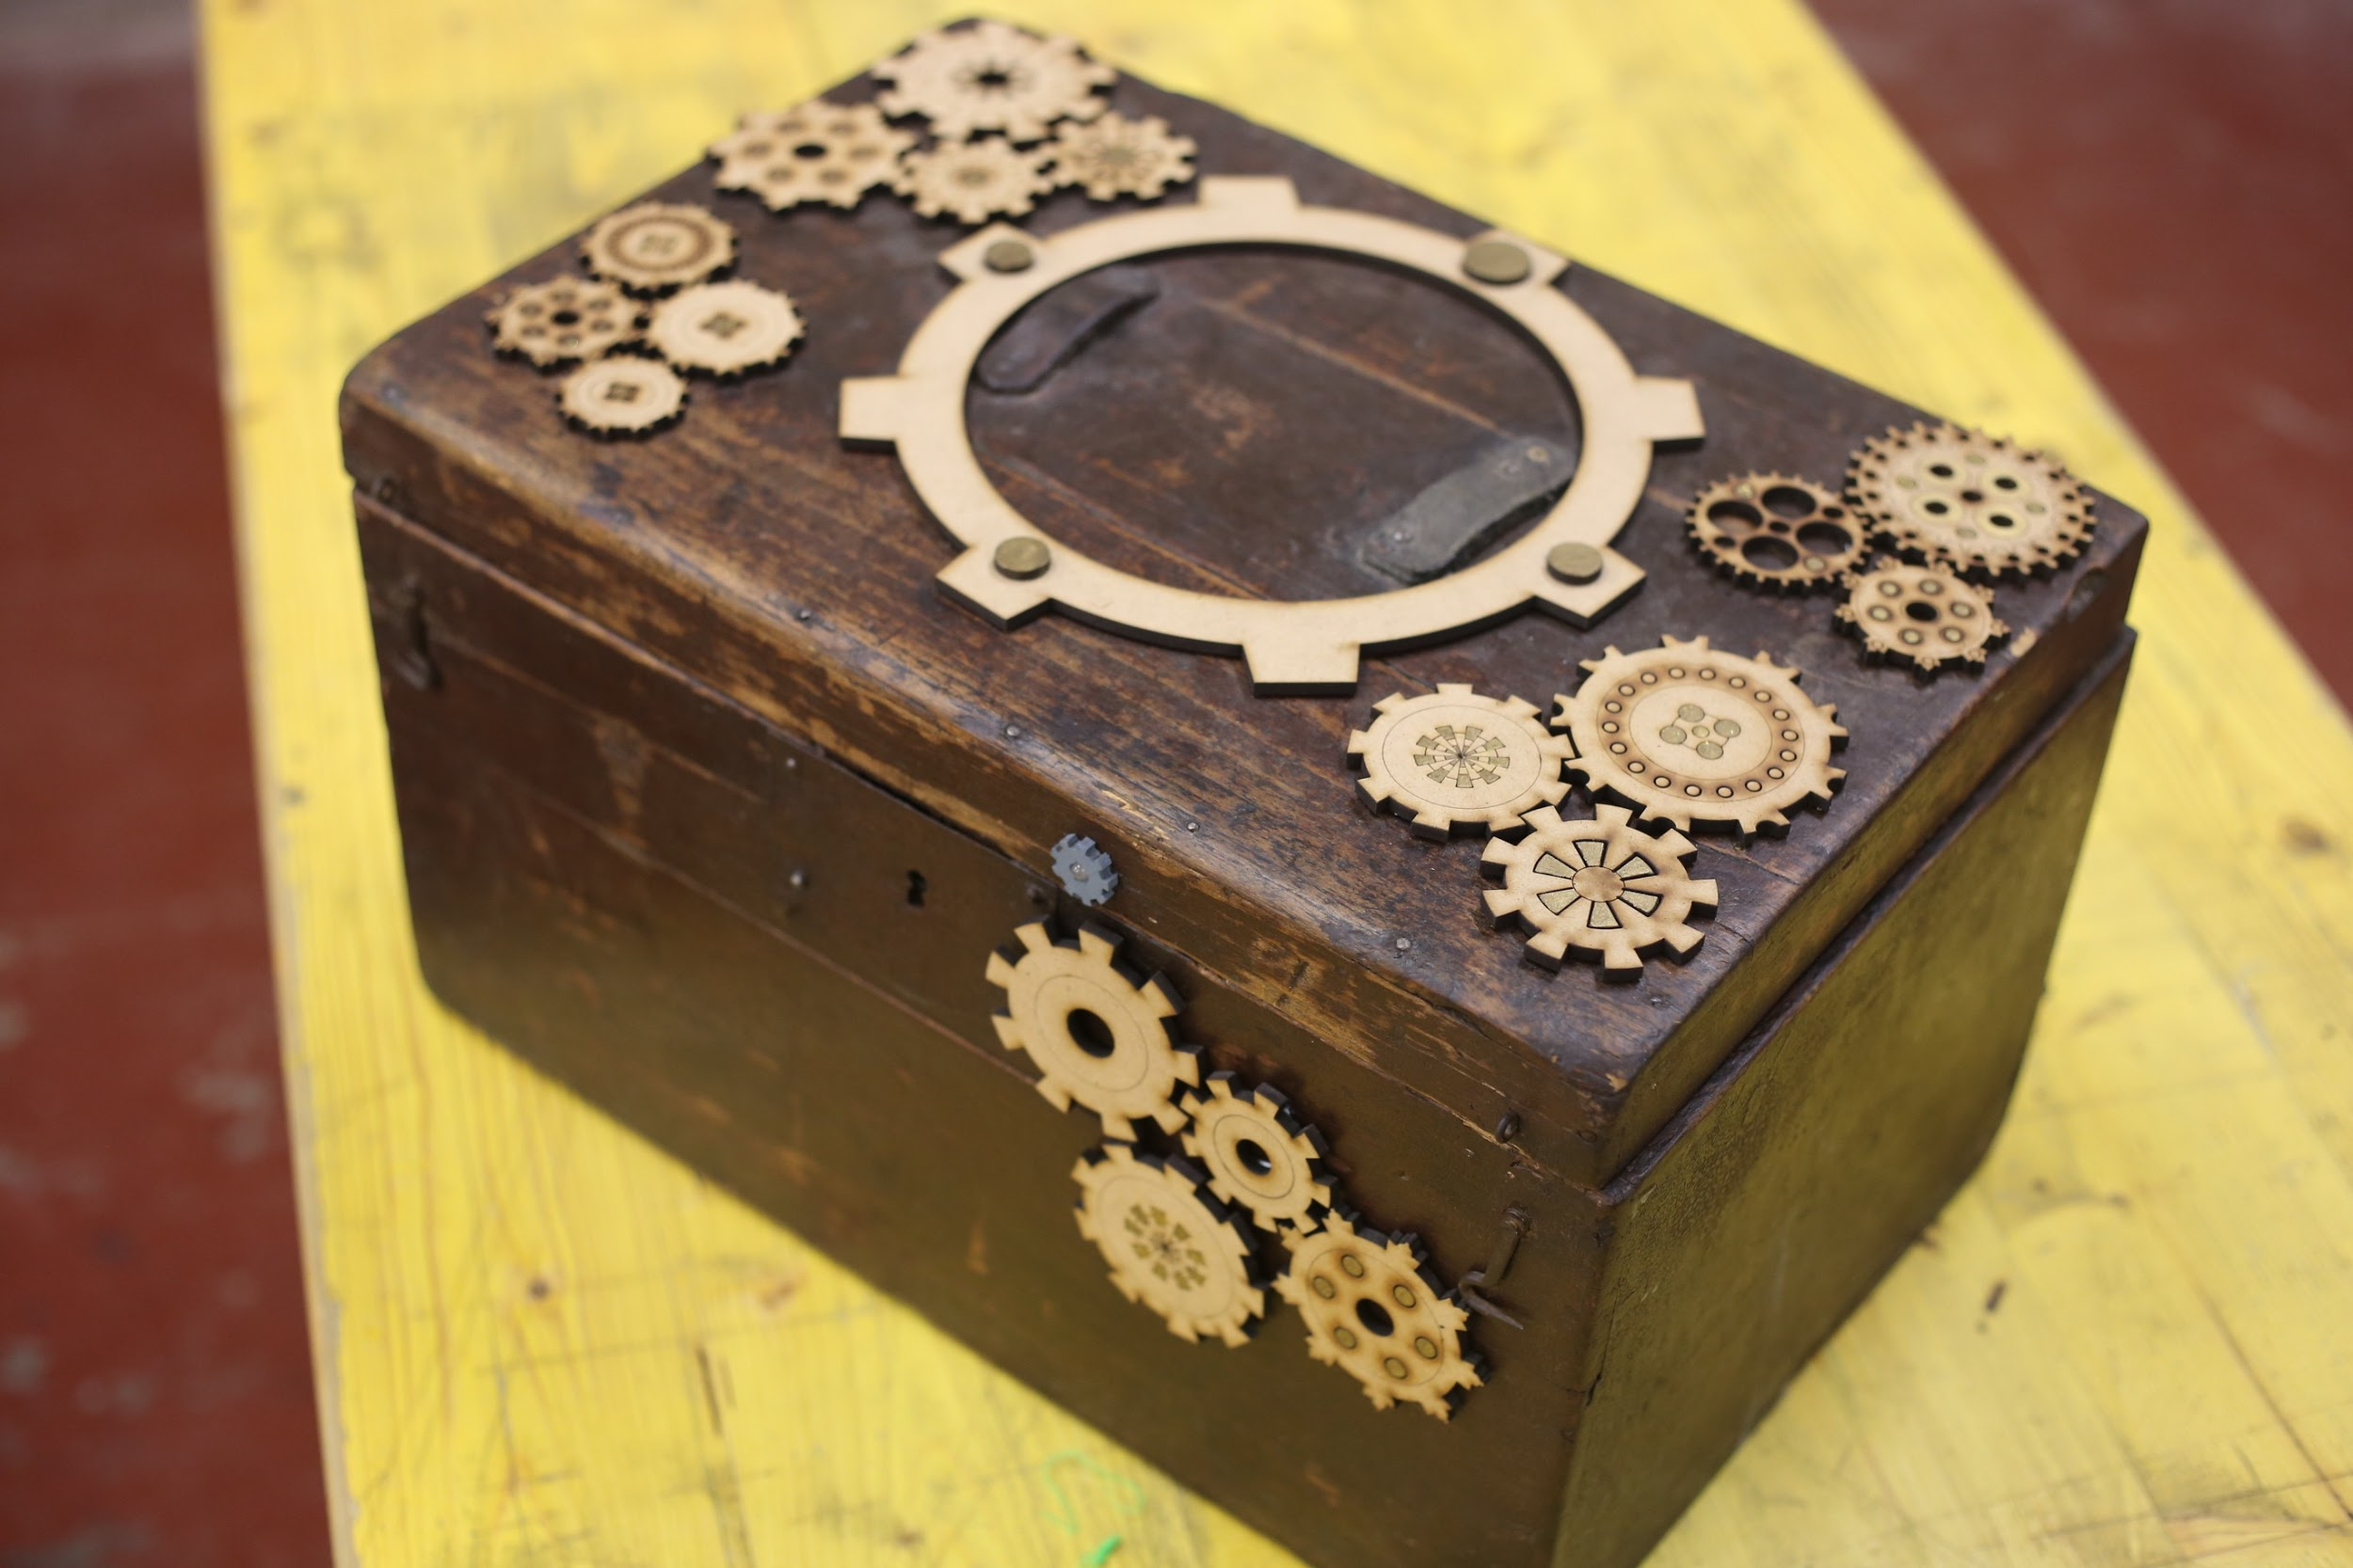
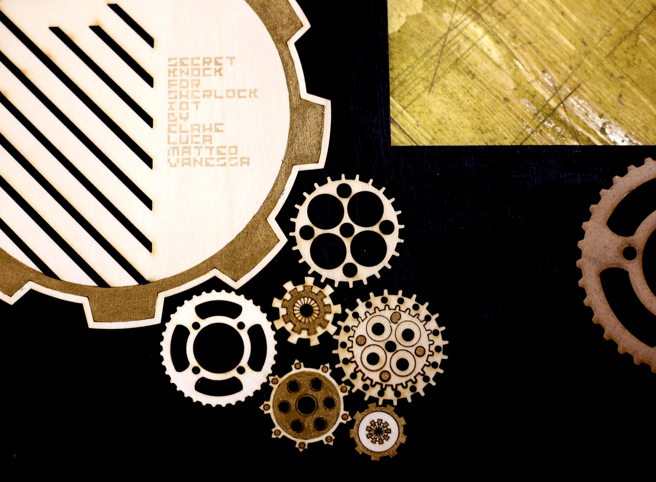
HARDWARE
We used an old wooden box. We added different kinds of gears maked cutting pieces of wood with the laser cutter, to make it more “Steampunk style”.

Slide 7
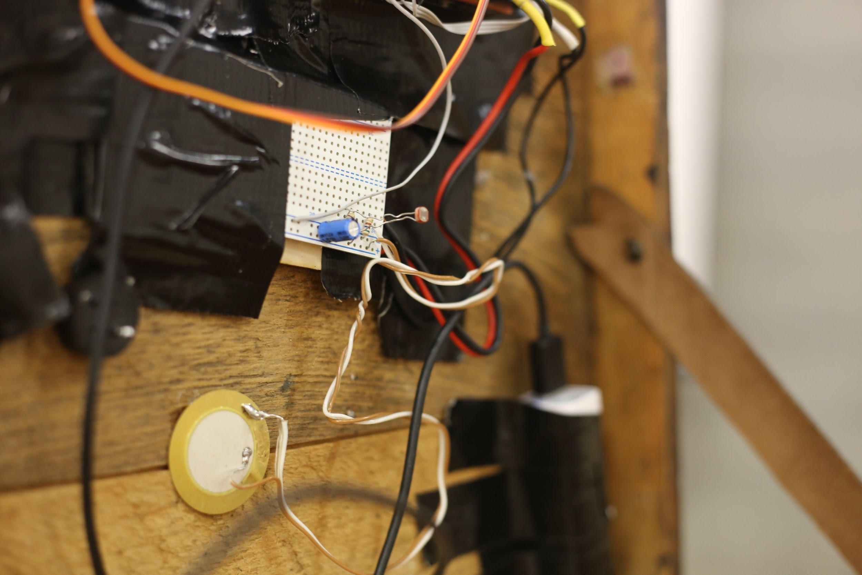
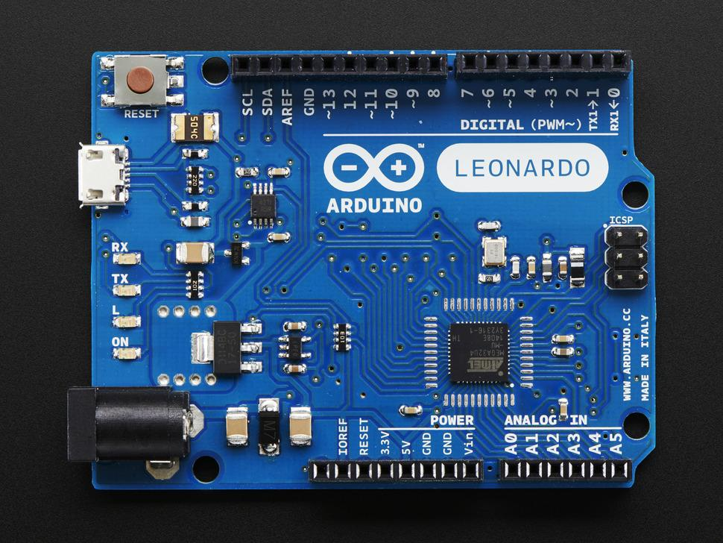
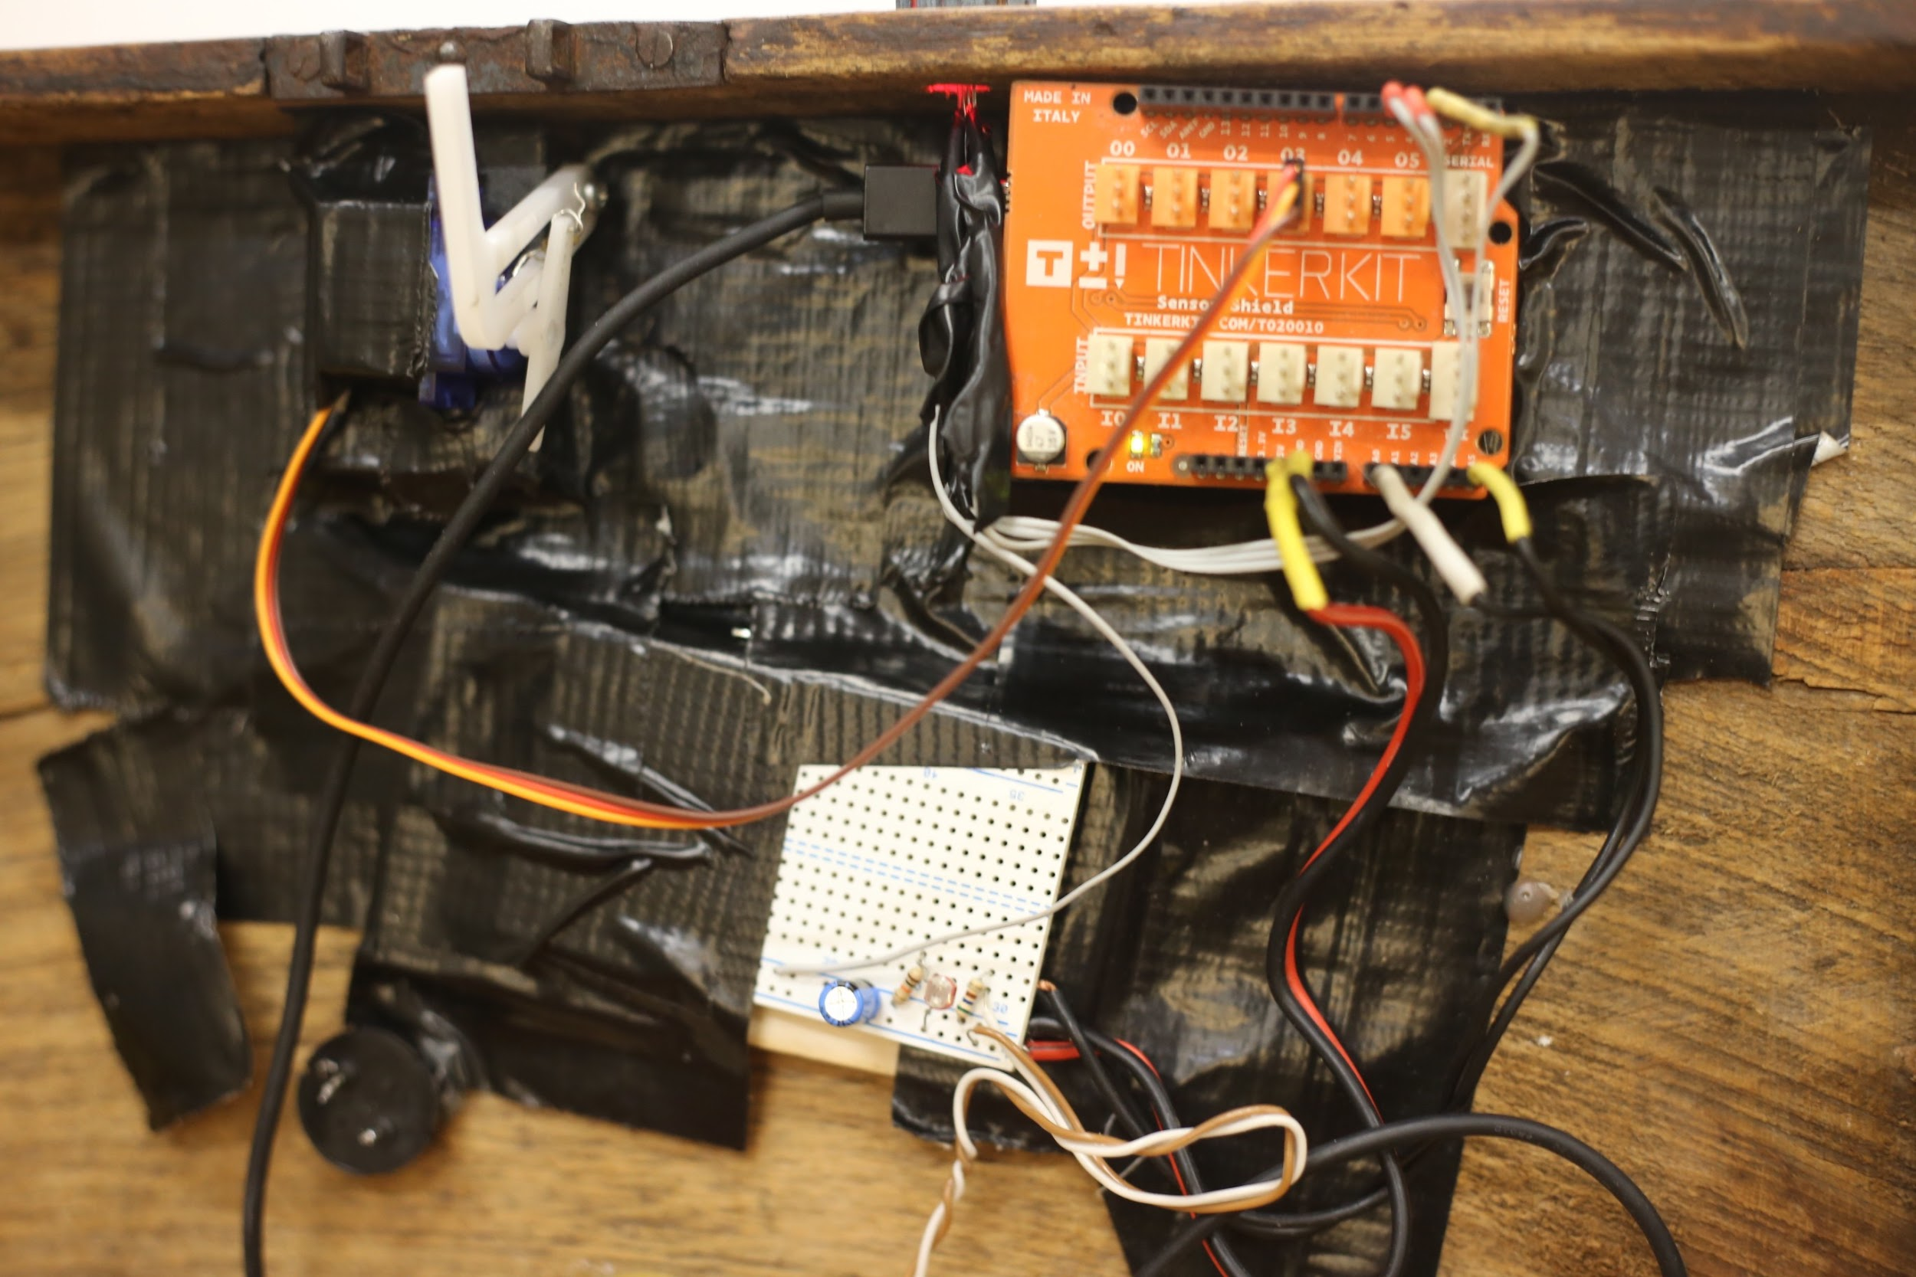
HARDWARE
We used to connected all the elements of the mechanism a “Leonardo” Arduino card hidden inside the box.

Slide 8
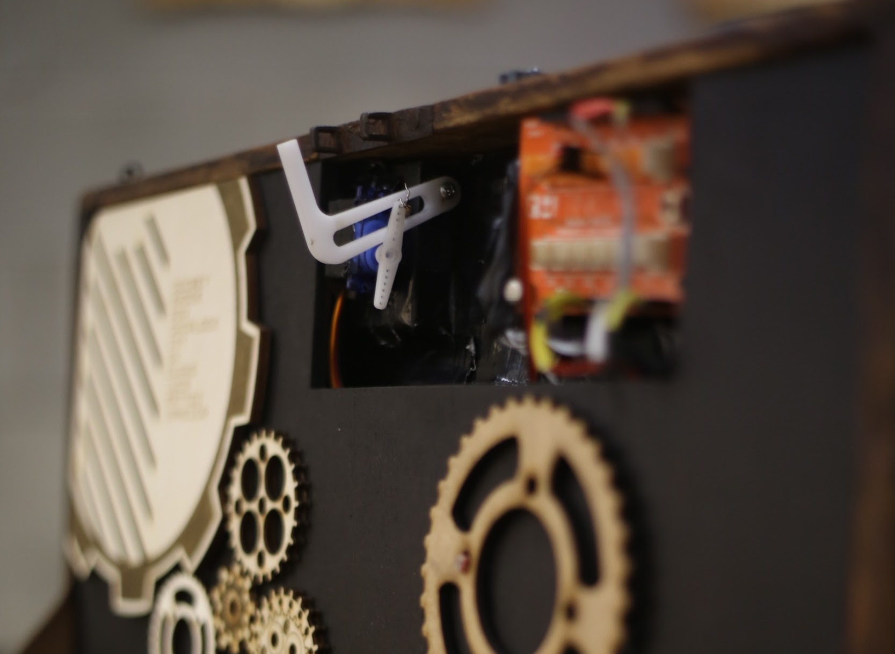
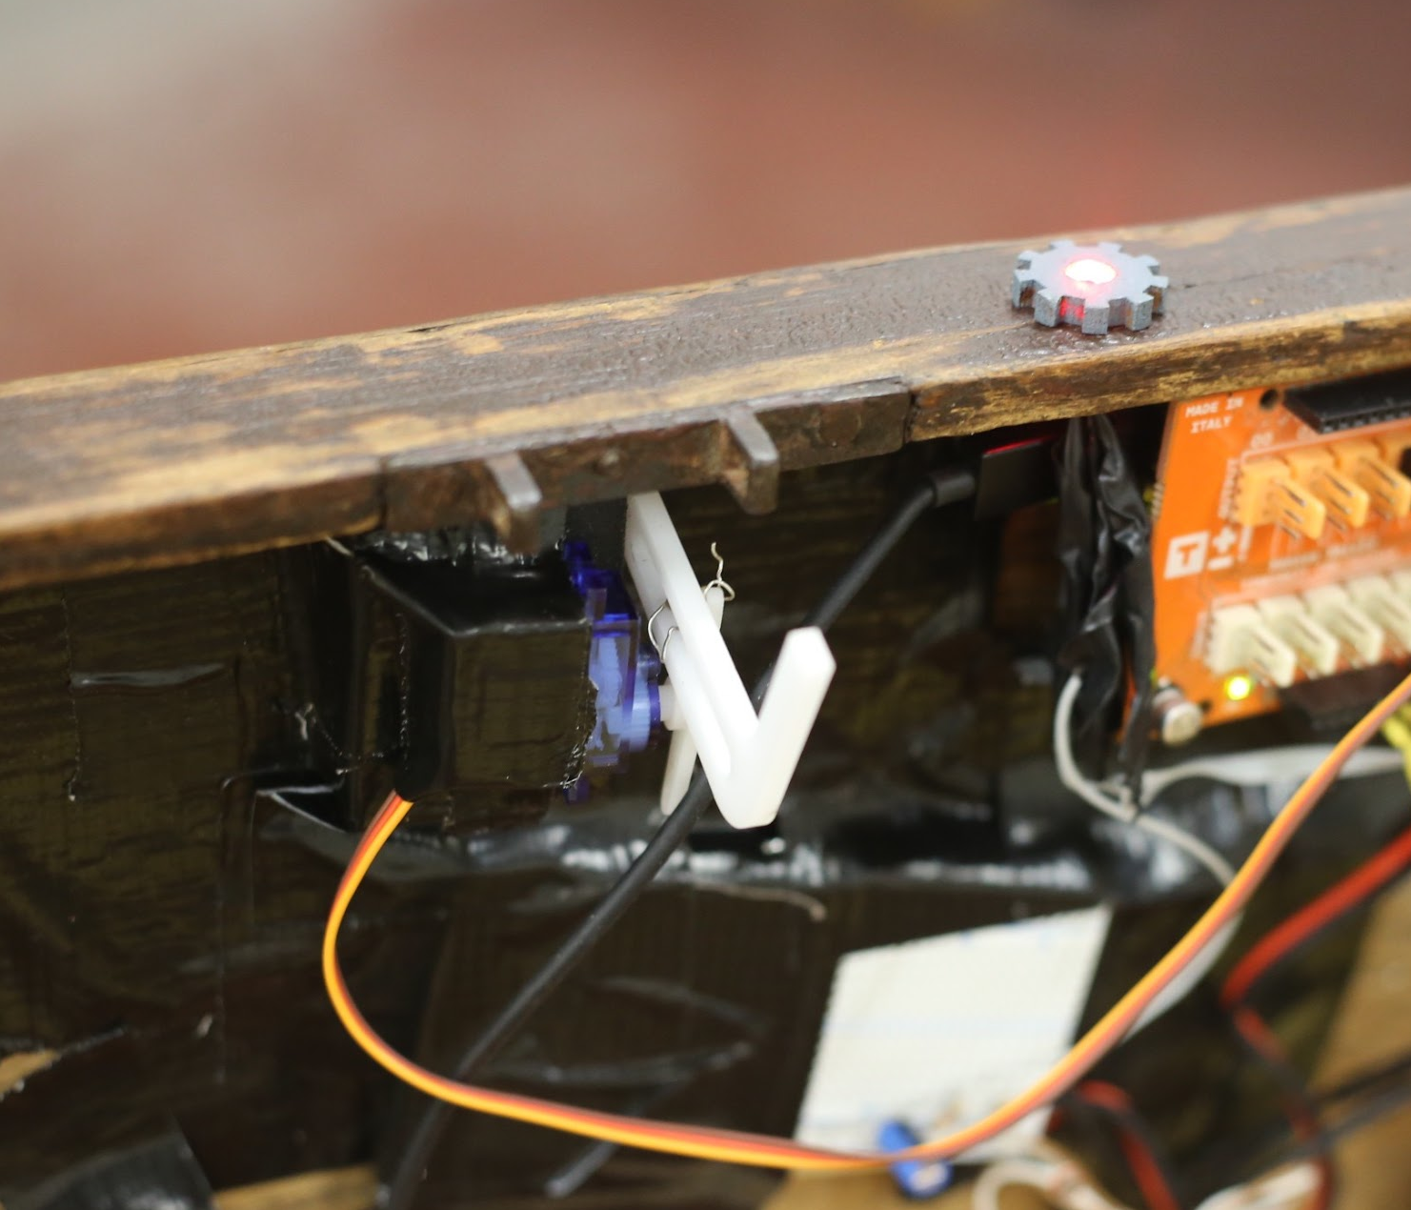
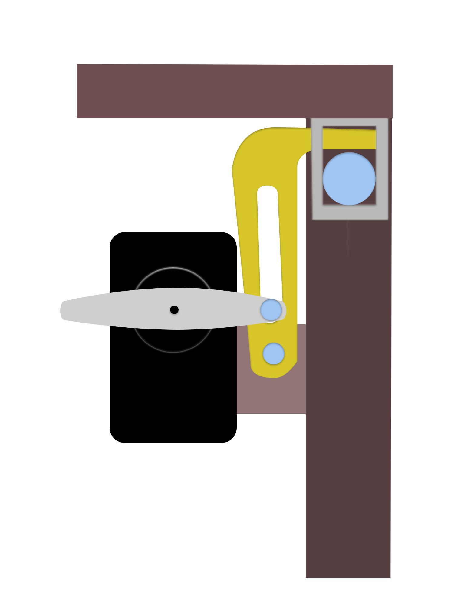
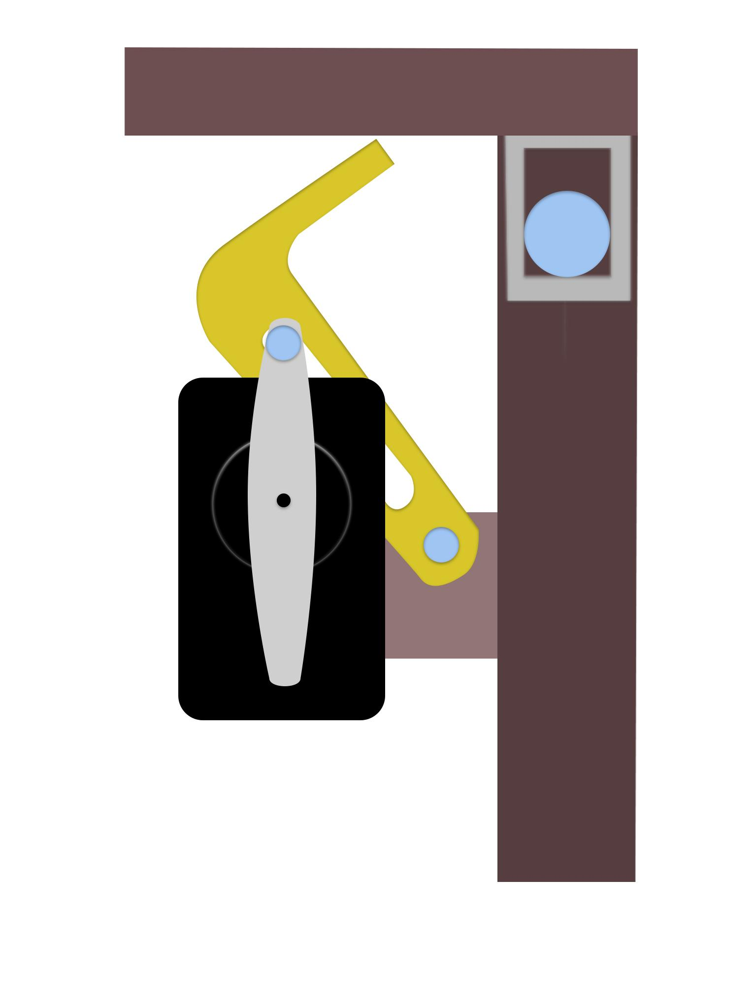
HARDWARE
For the lock, we cut a hook in plexiglass with the laser cutter. The hook is attached on a servo stucked under the cover of the box. By activating the mechanism, the servo will turn by 90°, making turn the hook and unlocking the box.
1
2

Slide 9
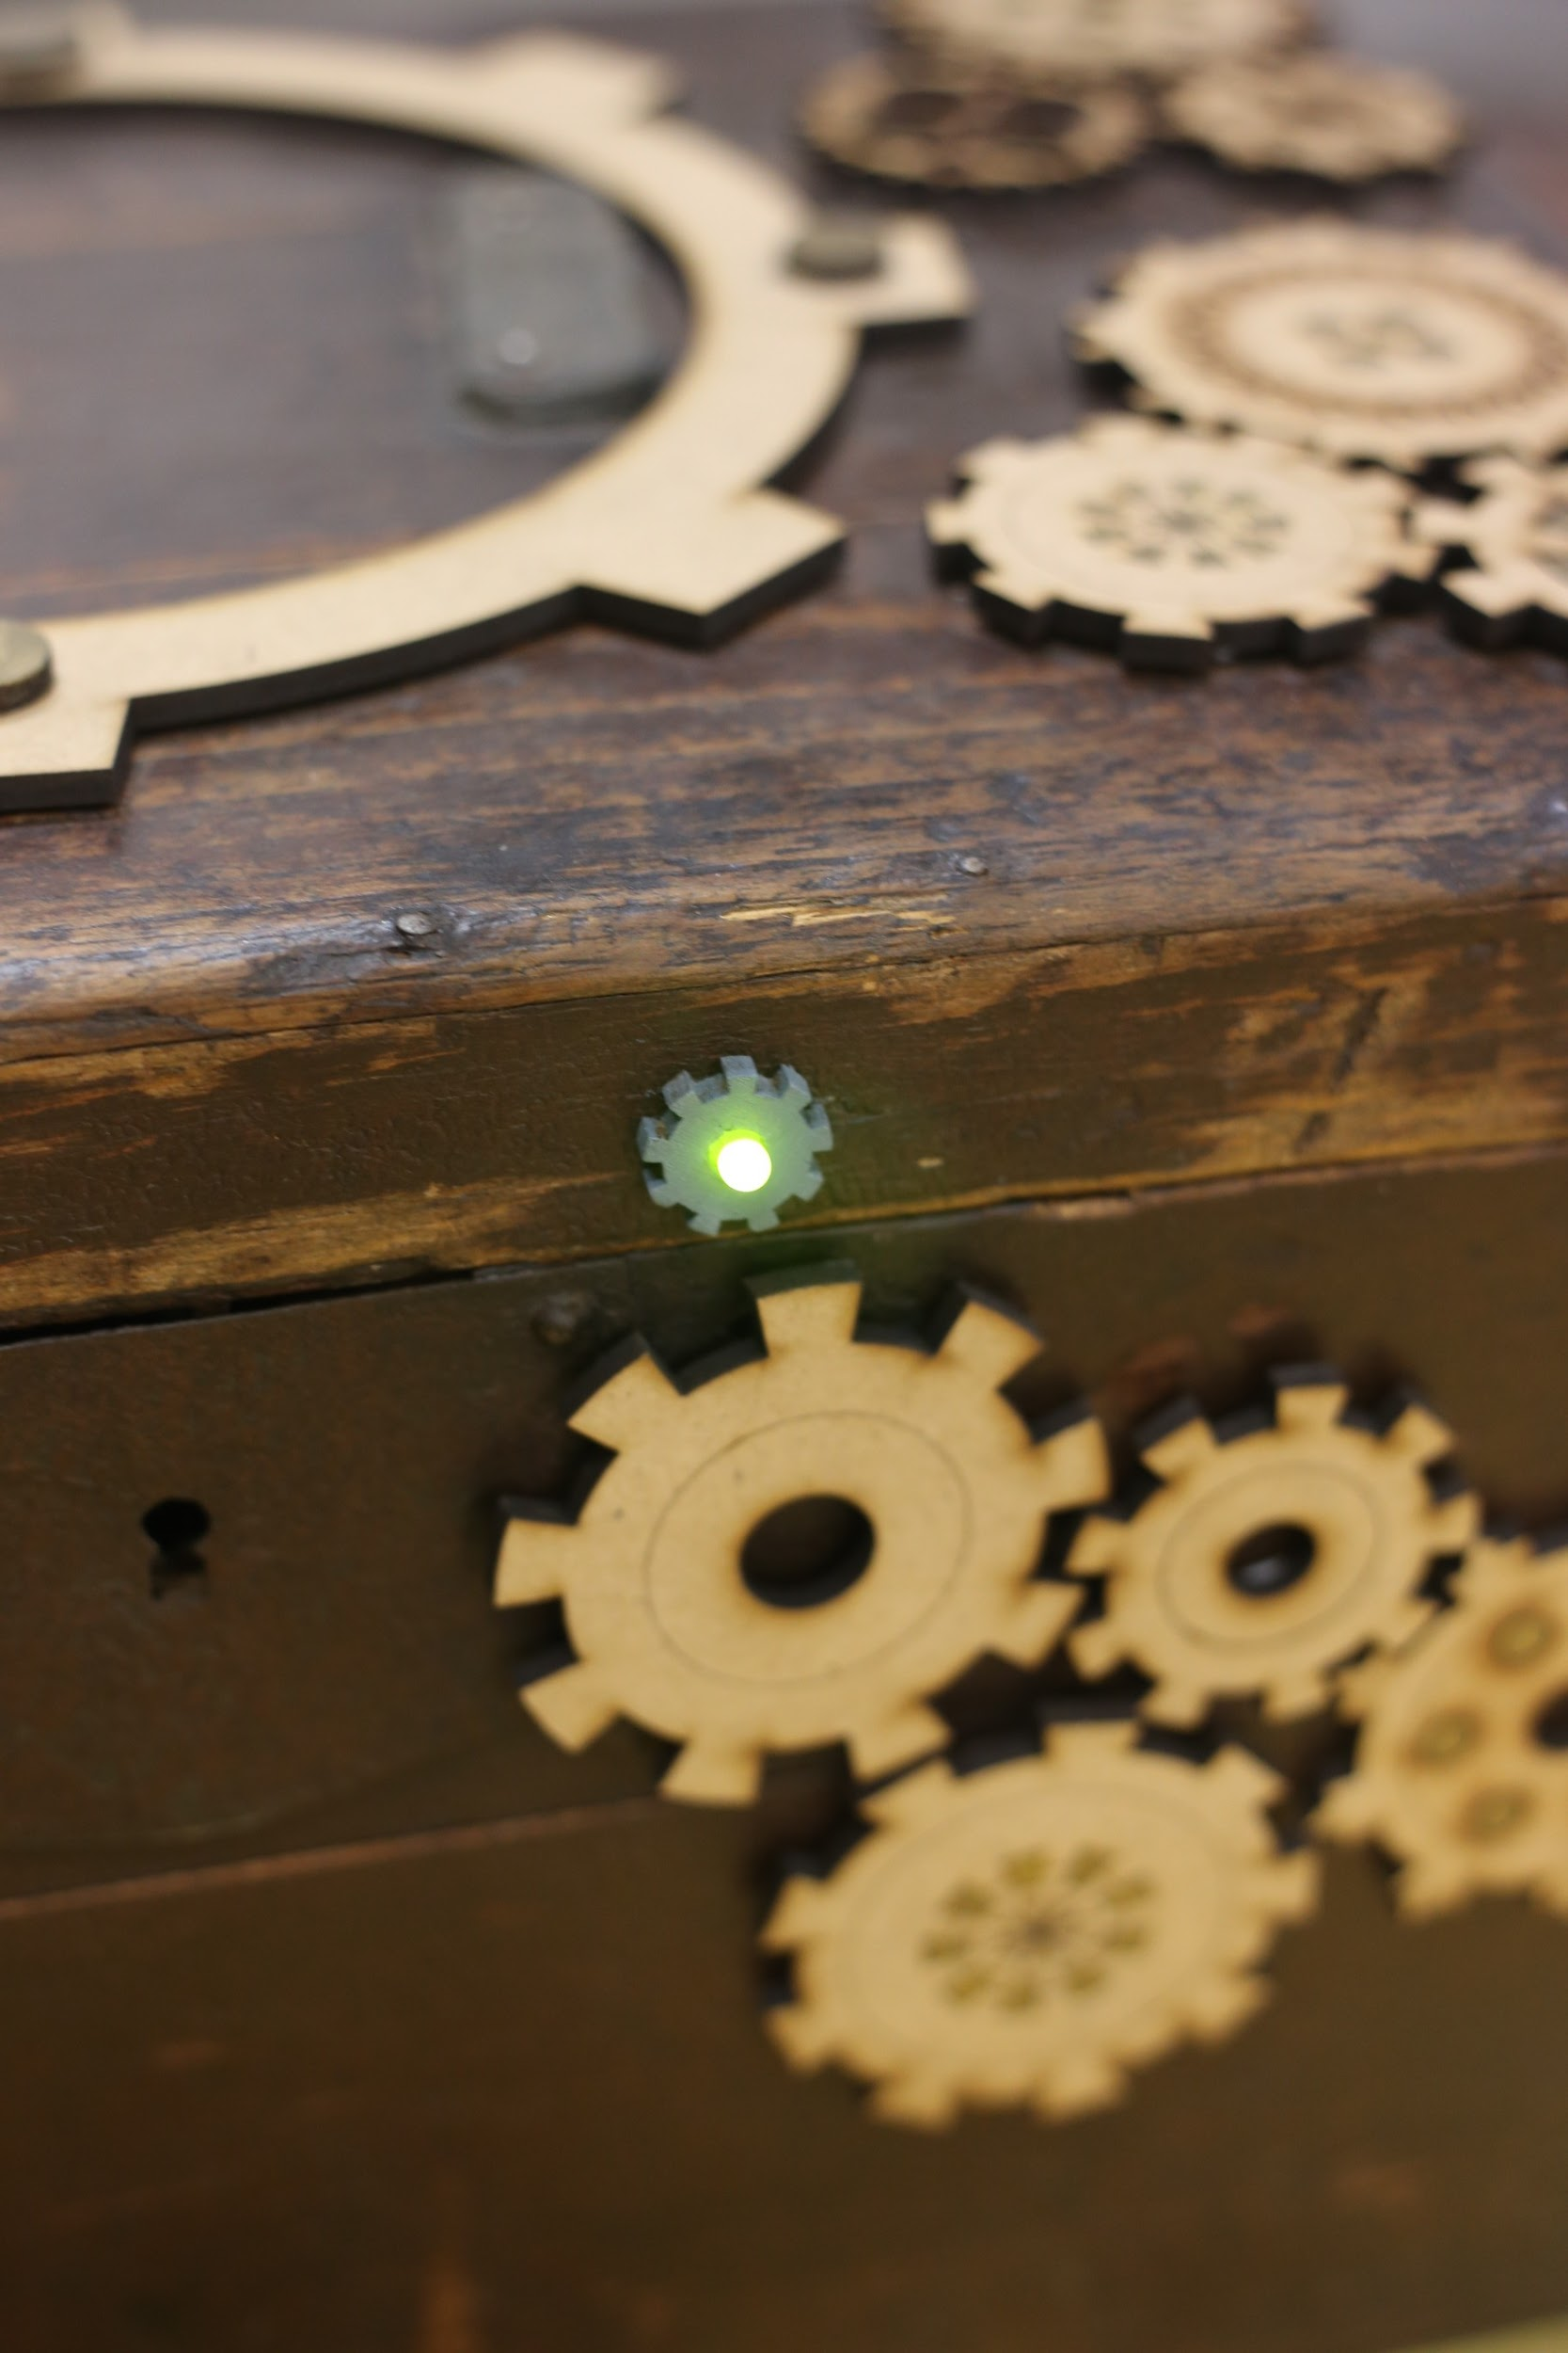
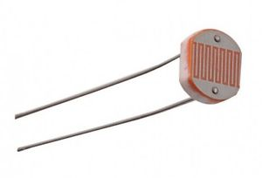
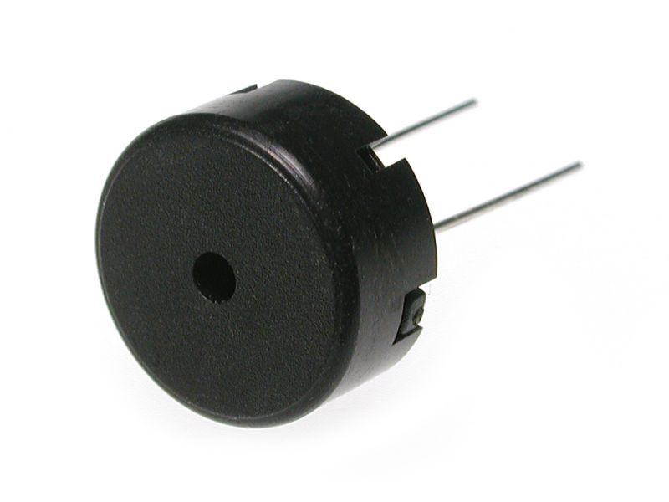
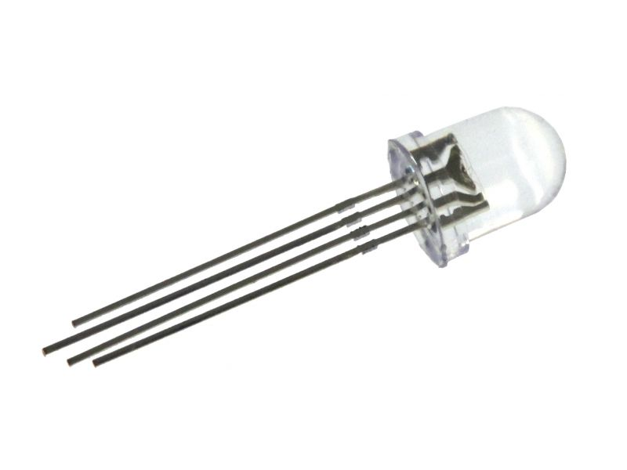
HARDWARE
We used a RGB led located on the front size of the box, that will change color when the signal of opening is activated.
To receive the signals of the knocks we used a piezo, located on the insight of the cover of the
box.
To lock again the box, we used a photoresistance that, when the box will be closed and the light will be <50, will activate the locking system.

Slide 10
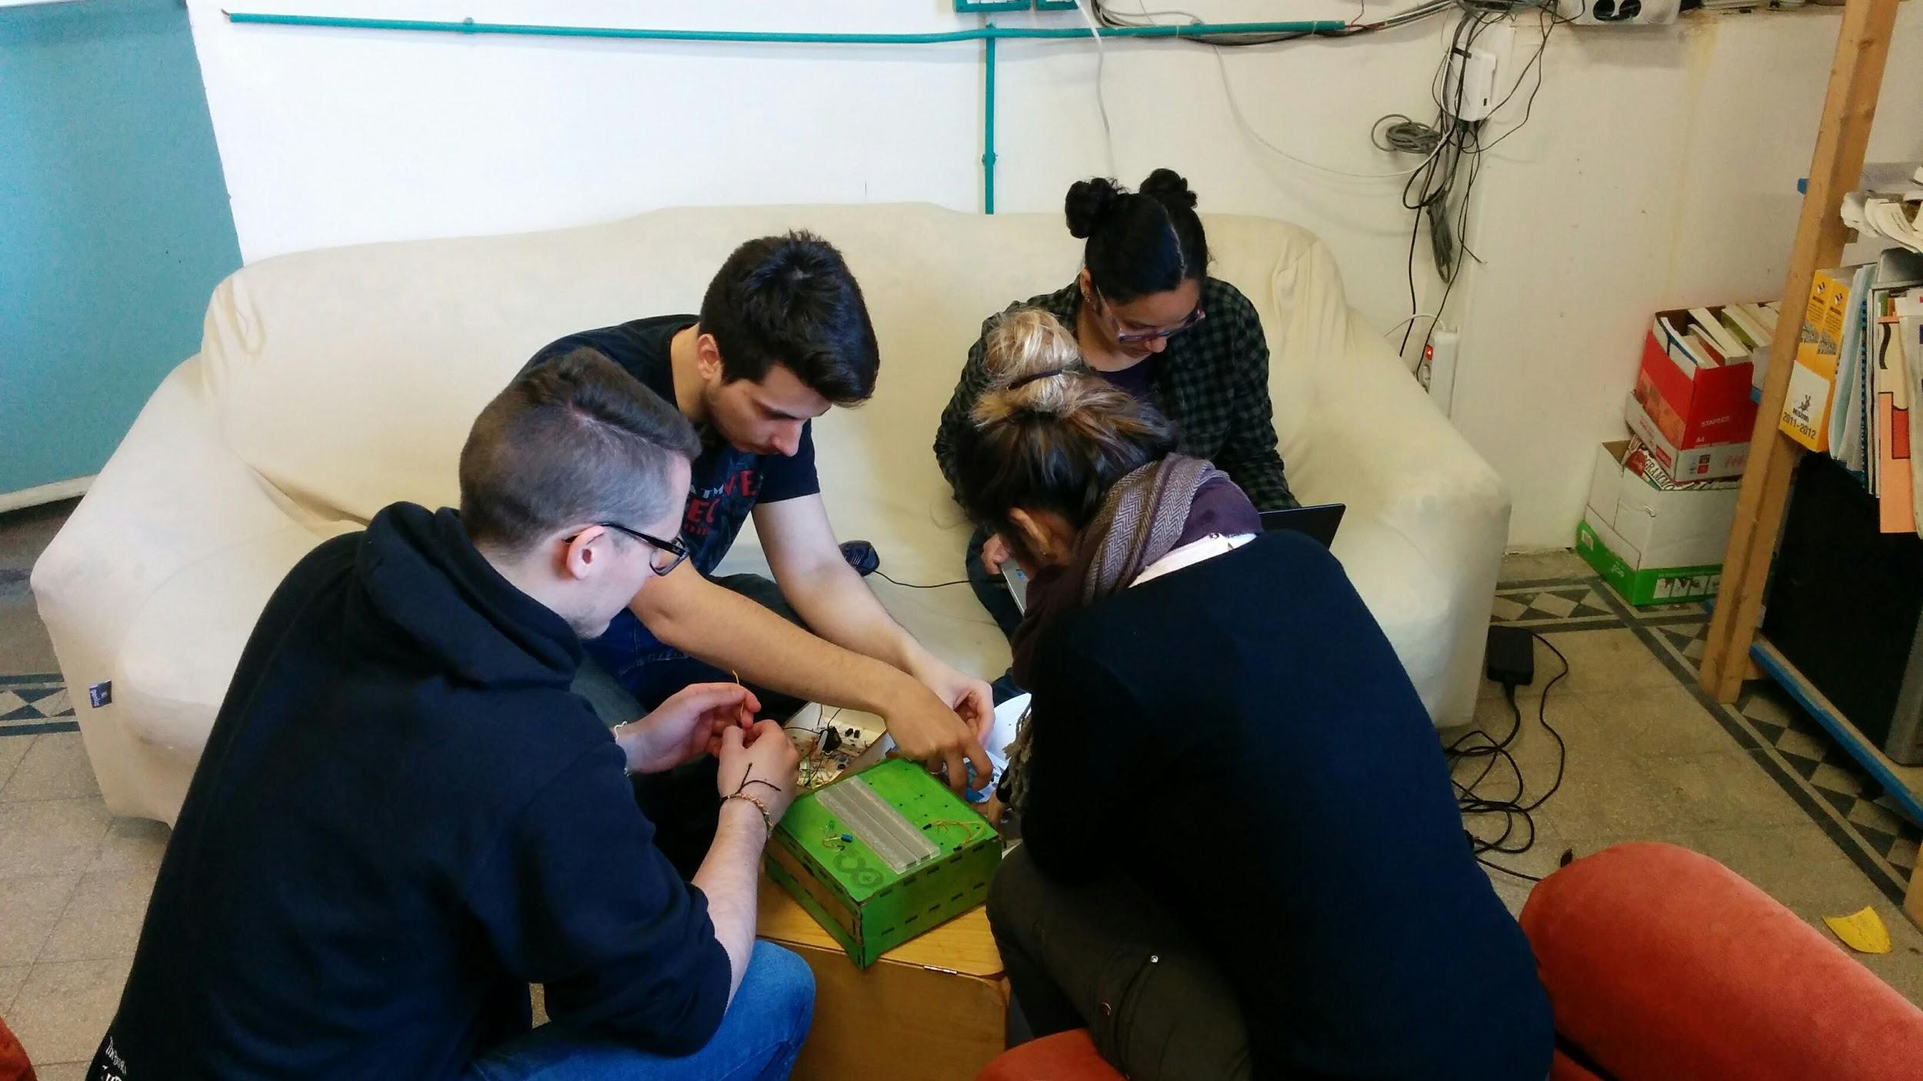
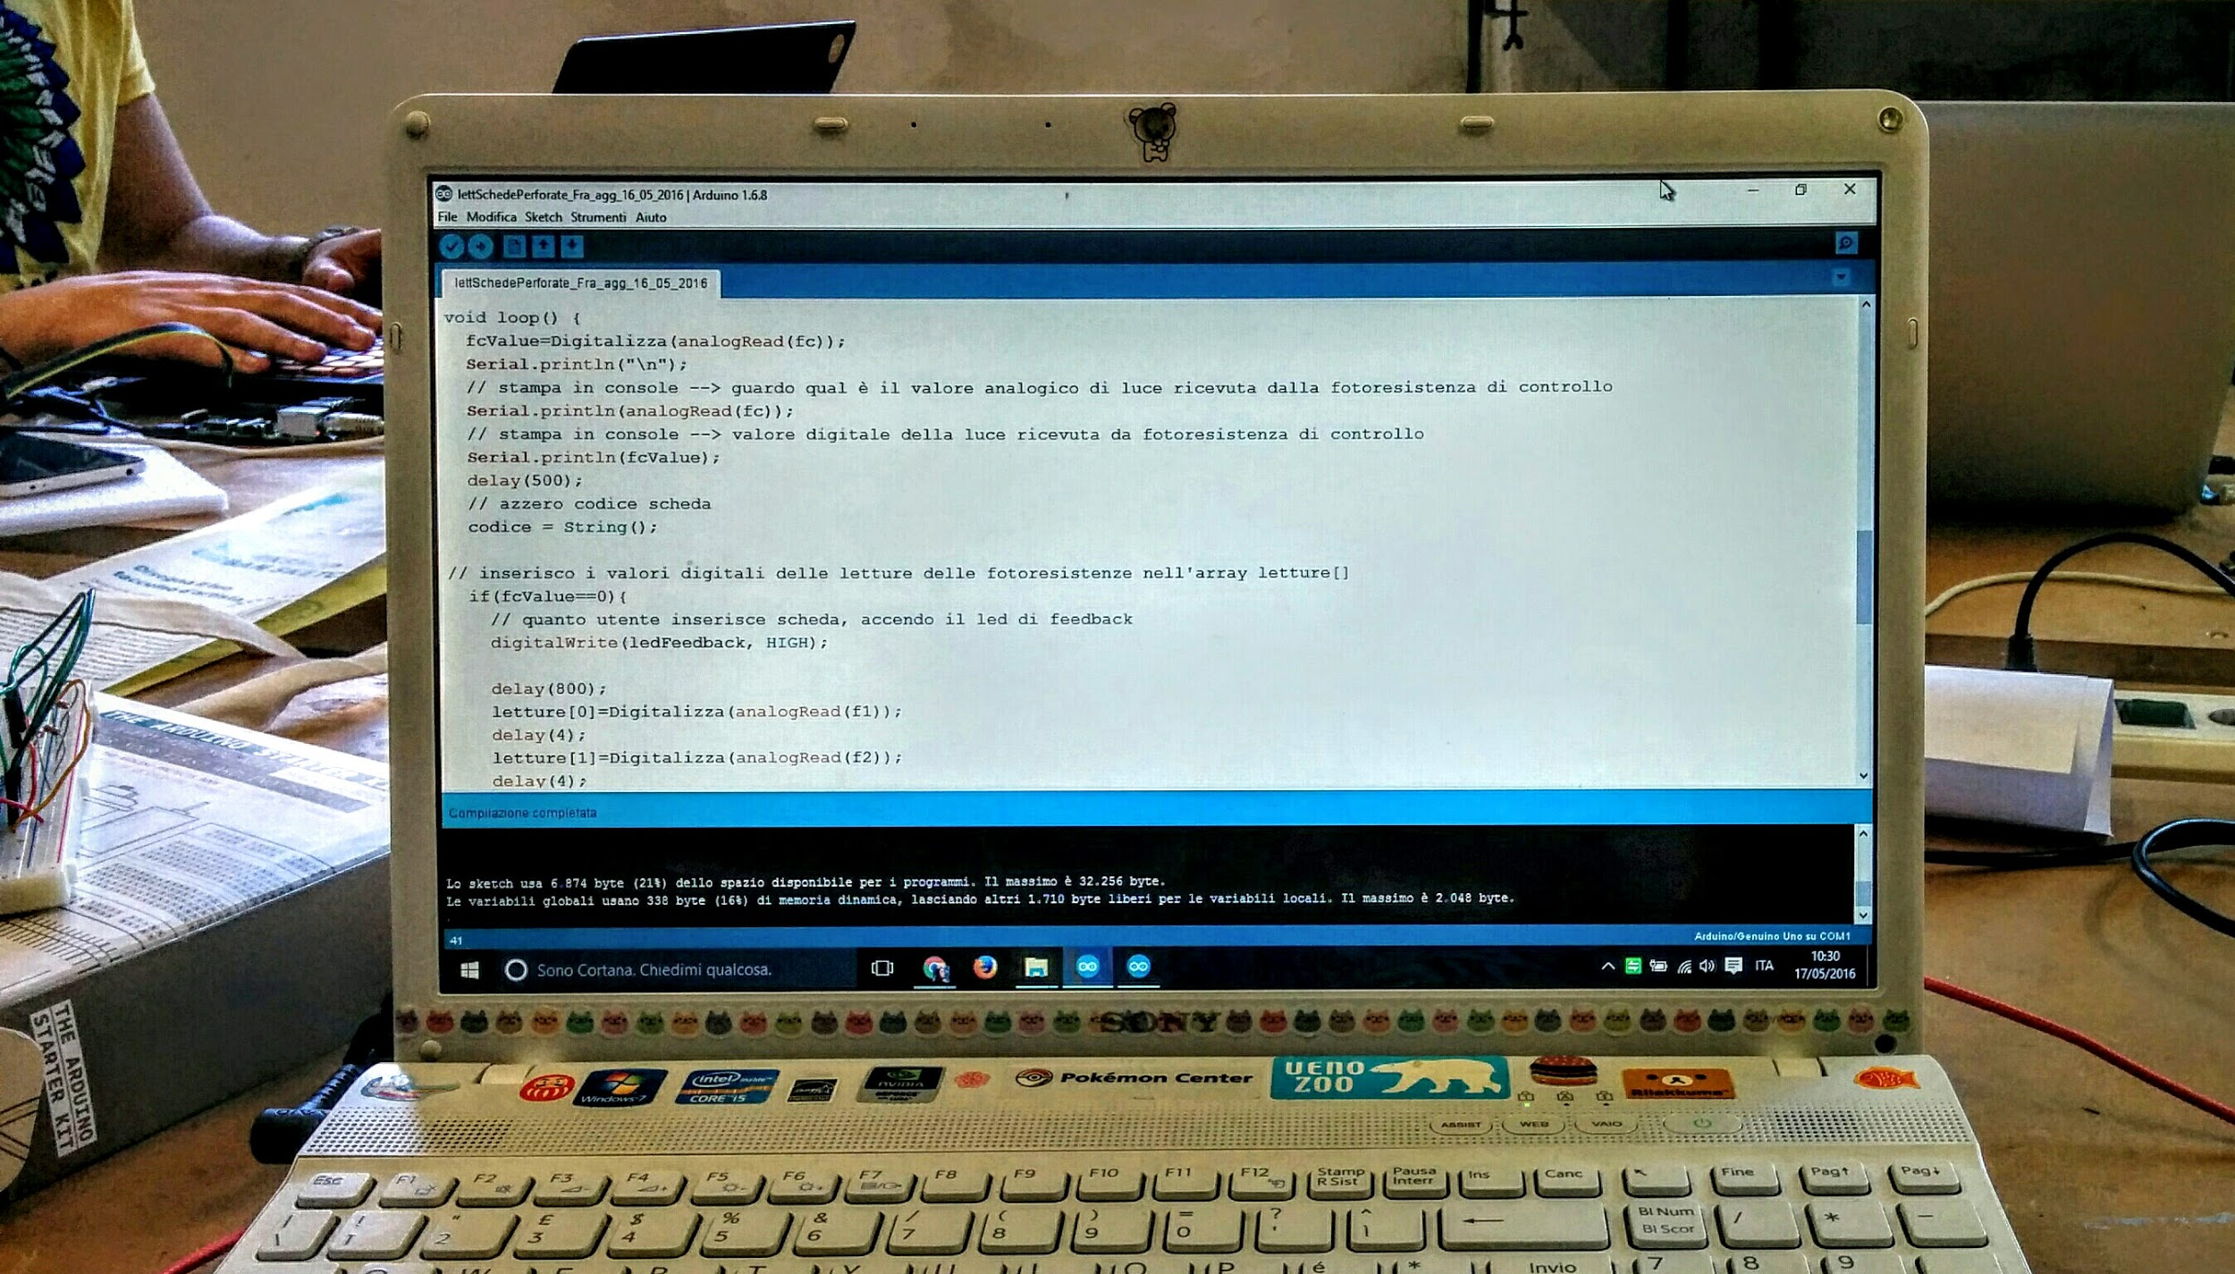
SOFTWARE
The function used with the Arduino card is “Knock Lock”.
We thought about using a combination of knocks executed after a certain amount of time. As we
said before, when the piezo recognizes the right number of knocks, the program will make the
hook turn and the led changing colour into green.
For the lock, when the value of the photoresistance is under 50, the hook will turn again (waiting 5 seconds) locking the box and the led will turn red.
Every Time when a knock will be recognized, using a function of the program that checks the values
of the inputs, the led will turn yellow.

Slide 11
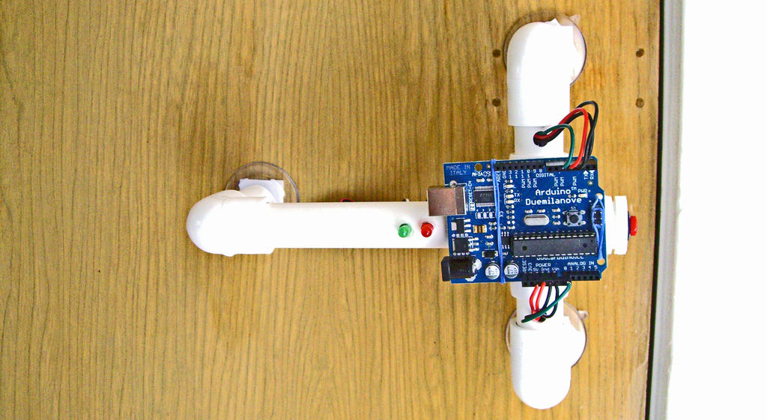
APPLICATIONS
The “Knock Lock”; box is a funny and useful tool to keep all our personal objects in security, thanks to his particular and unique secret combination.
It could be also used on a door, turning a simple room into a secret and private club, where only the people who knows the secret combination could get inside.

Slide 12
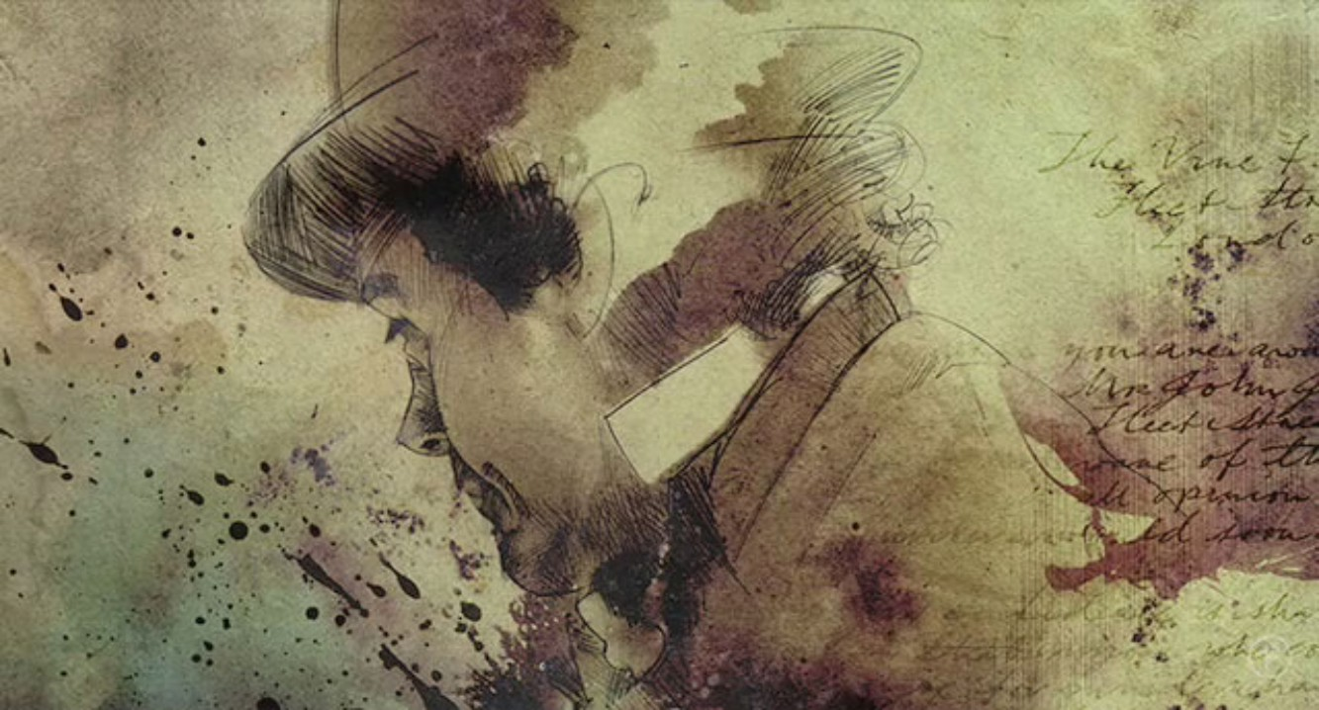
THANK YOU!

